Slide 1
Miroservice API Gateway
Notes:
Add instructor notes here.

Slide 2
What and Why API Gateway
An API gateway is a way to decouple the client interface from your backend implementation. When a client makes a request, the API gateway breaks it into multiple requests, routes them to the right places, produces a response, and keeps track of everything.
Notes:
What is the difference between API and API gateway?
-API is an acronym for Application Programming Interface. It is a set of definitions and protocols
that allow technology products and services to communicate with each other via the internet.
-An API Gateway is used as the entry point for client requests to an API

Slide 3
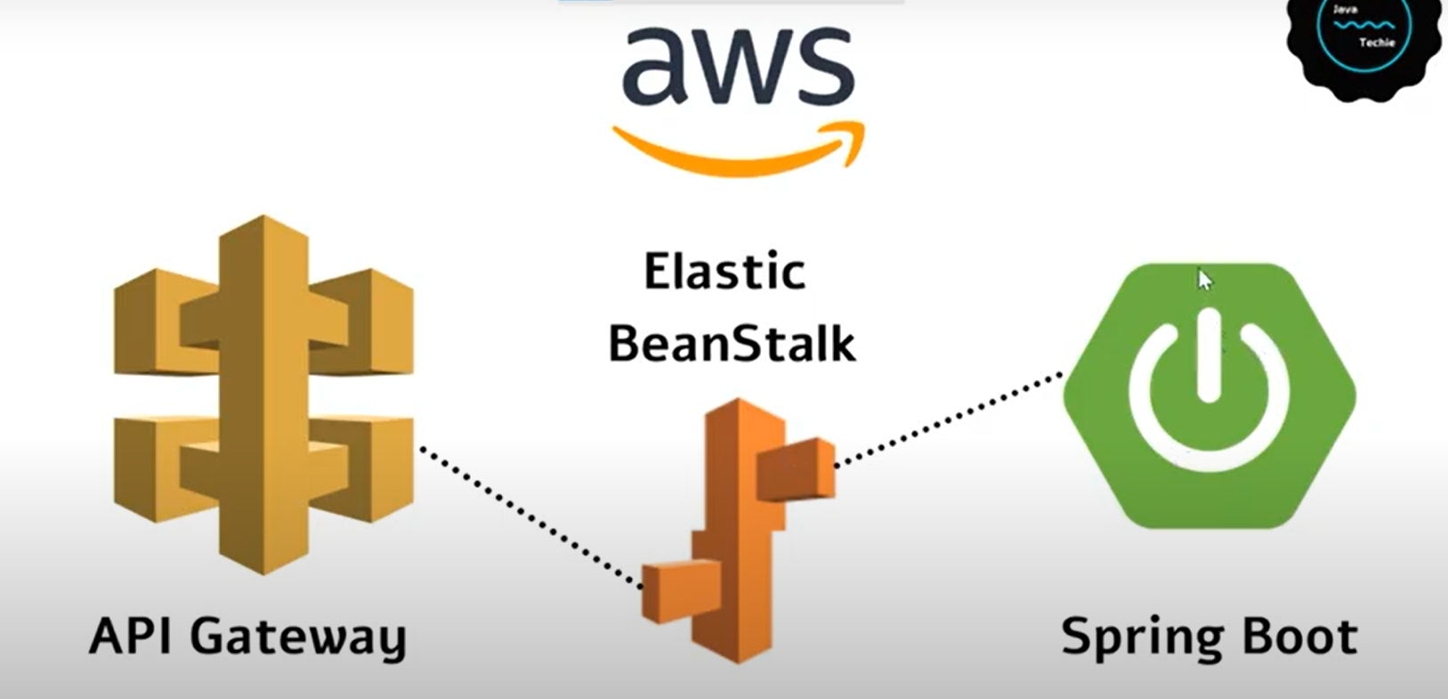
API Gateway

Slide 4
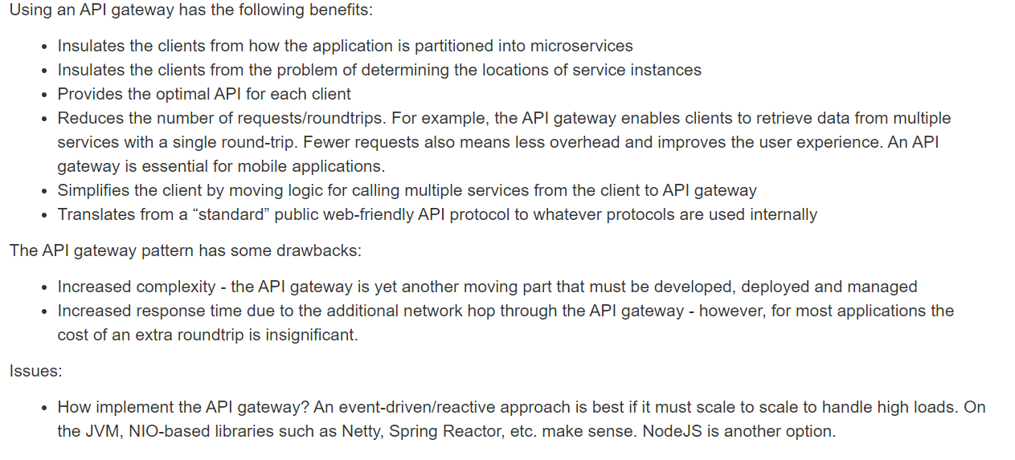
API Gateway- uses/pros/cons

Slide 5
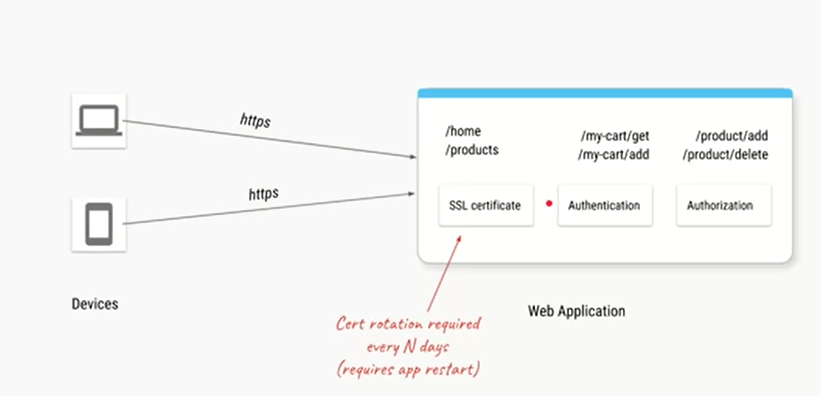
API Gateway- Why
Notes:
Since authorization, authentication and SSL certificate to use https protocol
is not the part of your shopping business logic you can separate it using API Gateway

Slide 6
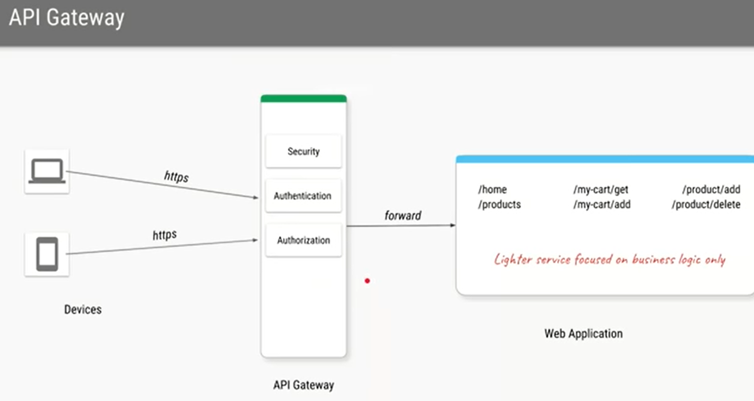
API Gateway- Why

Slide 7
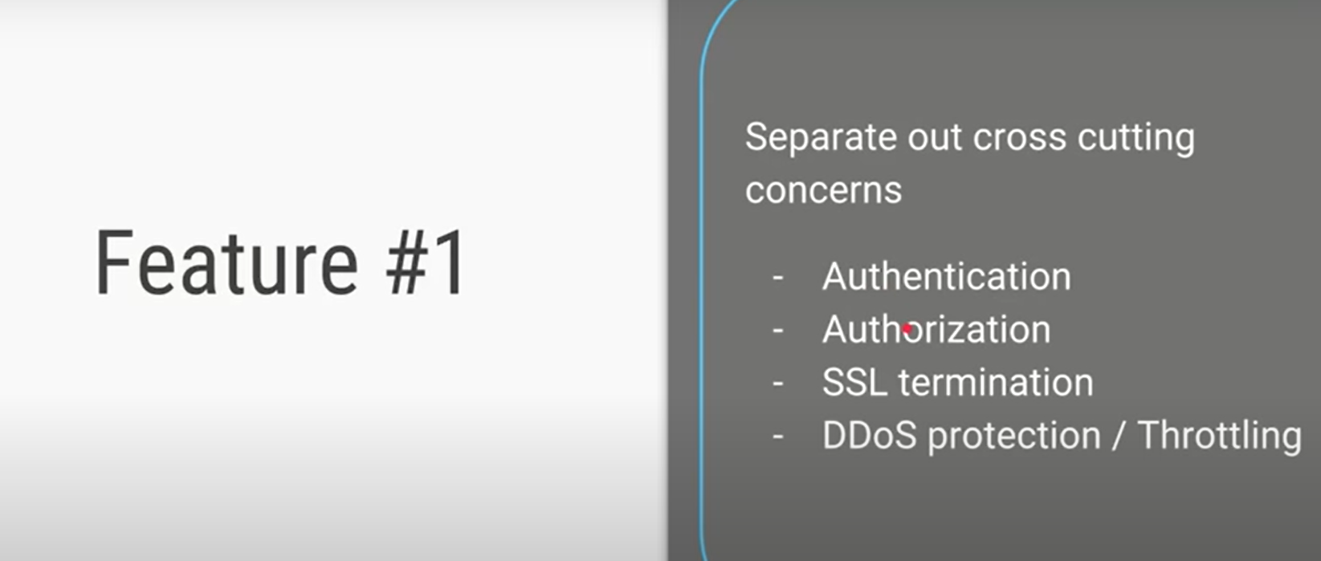
API Gateway- Why

Slide 8
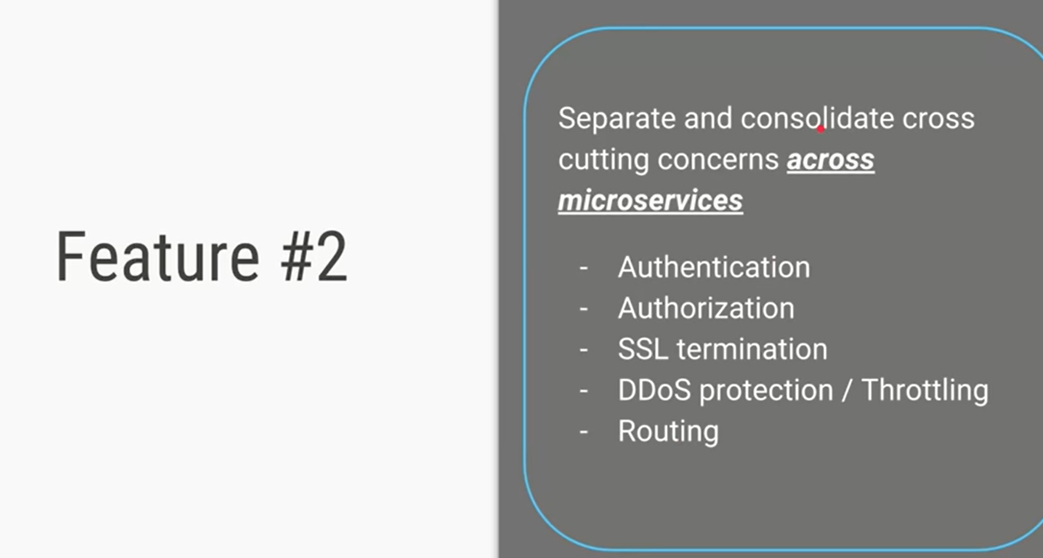
API Gateway- Why

Slide 9
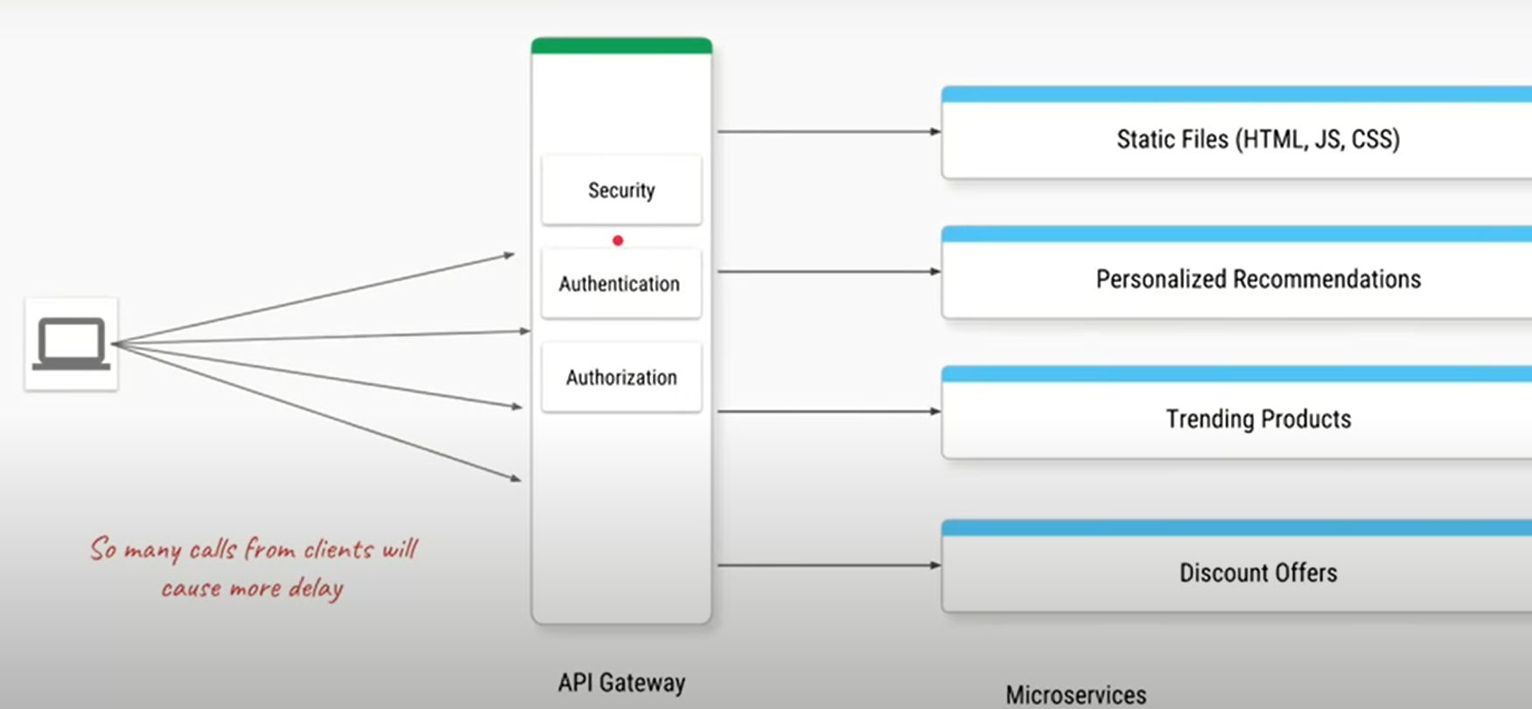
API Gateway- Why

Slide 10
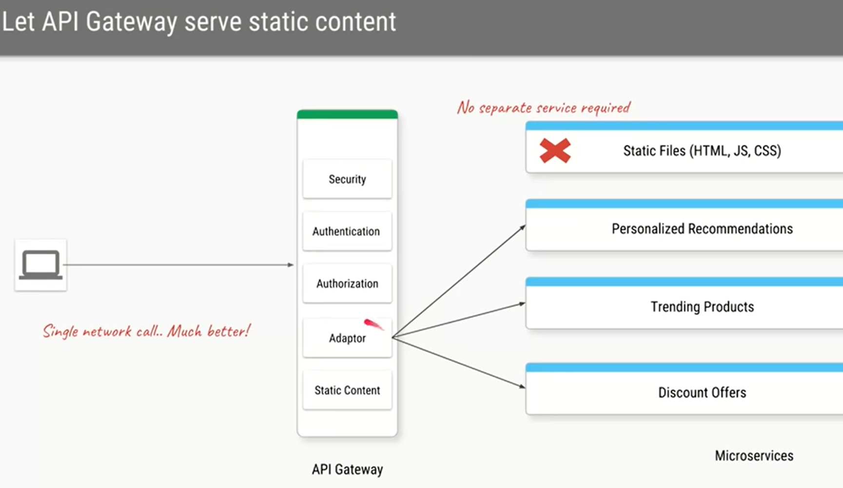
API Gateway- Why

Slide 11
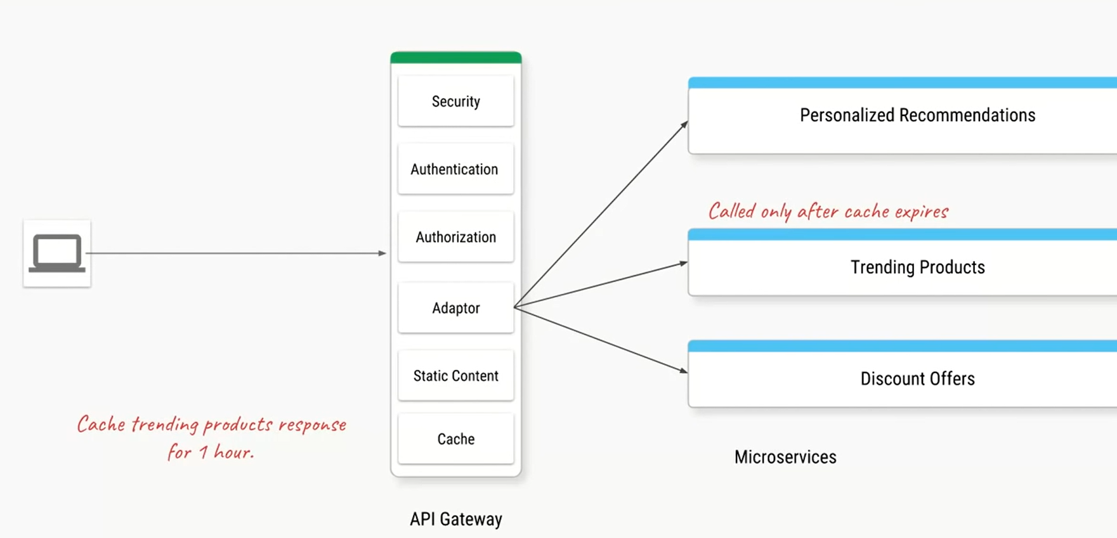
API Gateway- Why

Slide 12
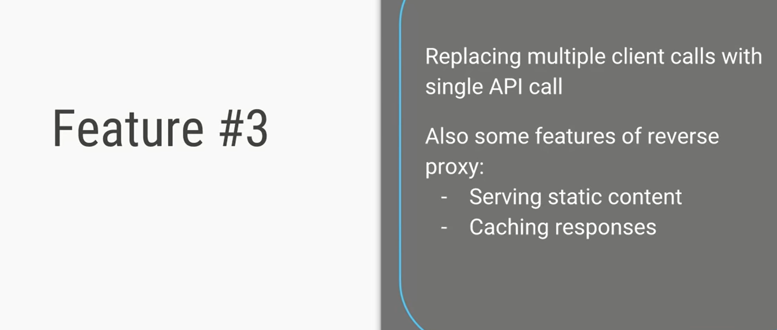
API Gateway- Why

Slide 13
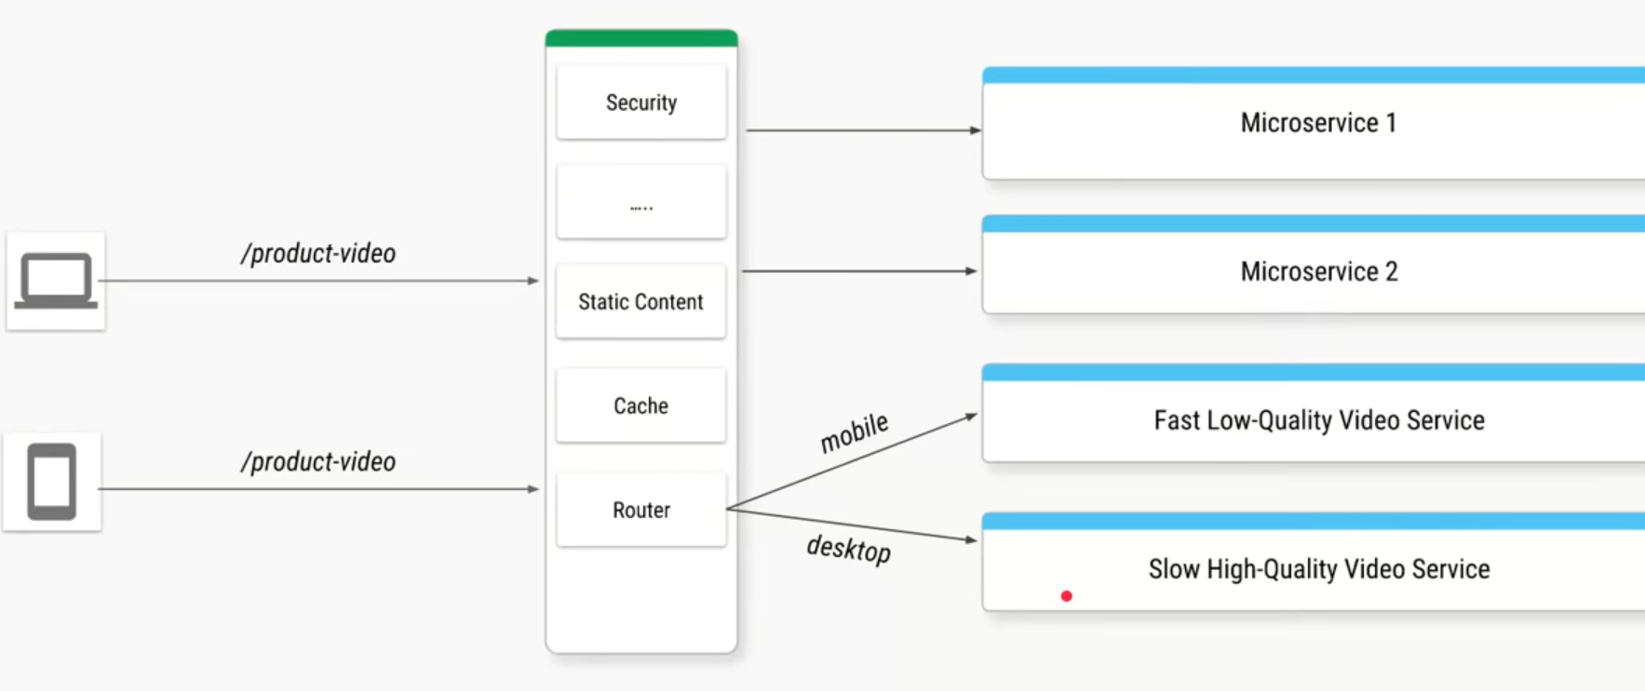
API Gateway- Why

Slide 14
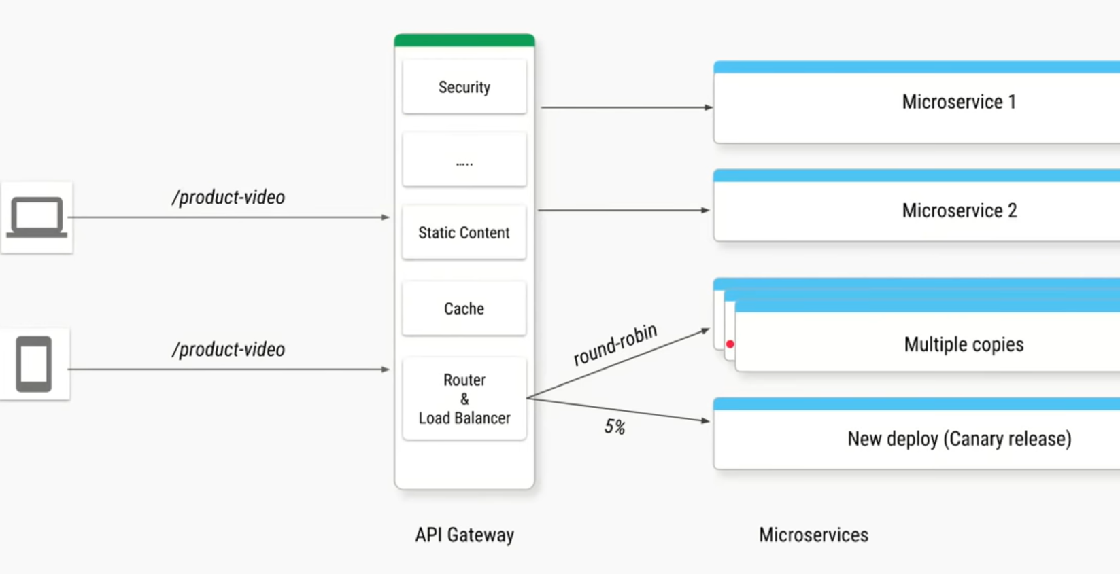
API Gateway- Why

Slide 15
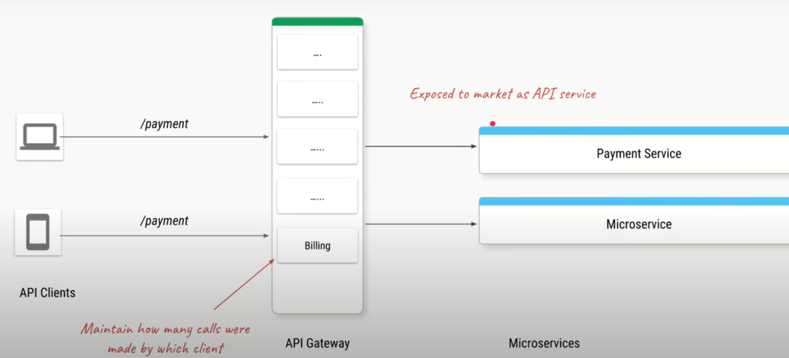
API Gateway- Why

Slide 16
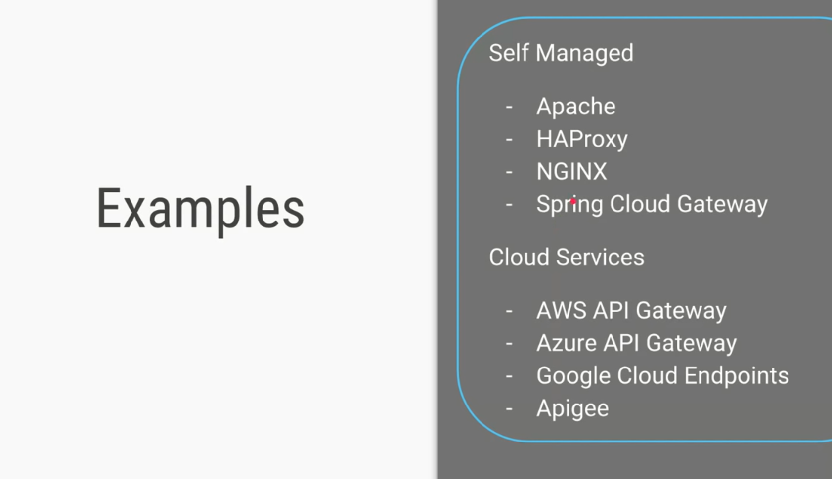
API Gateway- Why
Notes:
If you are deploying your application in your own virtual machine or in your own data centre
Then you can use any of above from Self managed. And if you deploy your
application on cloud then you can use any of the cloud service
-------------------------------------------------------
Netflix Zulu went into the maintenance mode

Slide 17
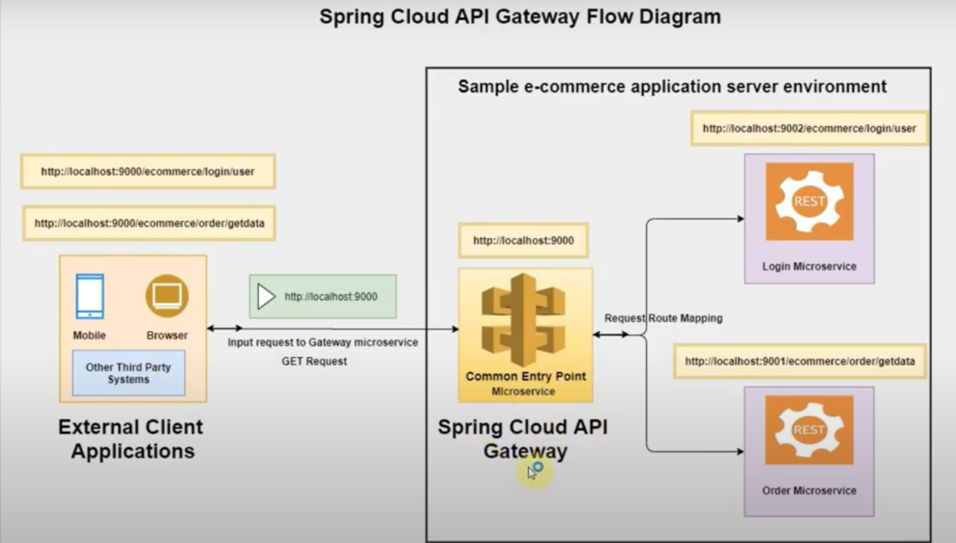
Demo-Example- API Gateway using Spring Cloud Gateway

Slide 18
Demo-Example- API Gateway using Spring Cloud Gateway

Slide 19
Demo-Example- API Gateway using AWS API Gateway
https://app.pluralsight.com/labs/detail/6f9ba023-36c3-42ba-a224-31ad28316419/toc

